Slide 1
RL for Macro Modelling
James Chapman

Slide 2
Executive Summary
RL recovers the solution to a range of baseline macroeconomic models
In principle, the RL implementations are indifferent to the functional form of the utility and production functions
RL implementations can trivially be extended to multiagent scenarios
Could train RL agent for one regime and see how they behave in another. E.g. train

Slide 3
Introduction

Slide 4


Constrained PV

Slide 5
Capital Accumulation

Slide 6
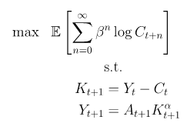
Simple Brock-Mirman

Slide 7

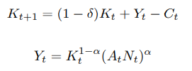
Brock-Mirman

Slide 8
Results

Slide 9
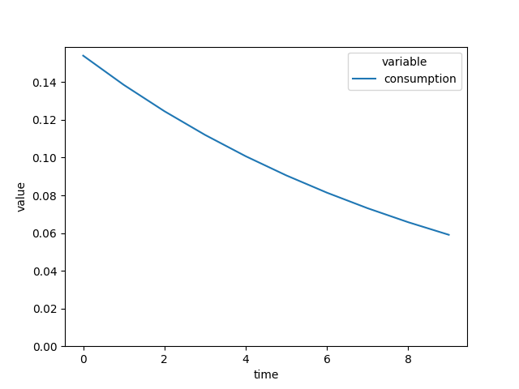
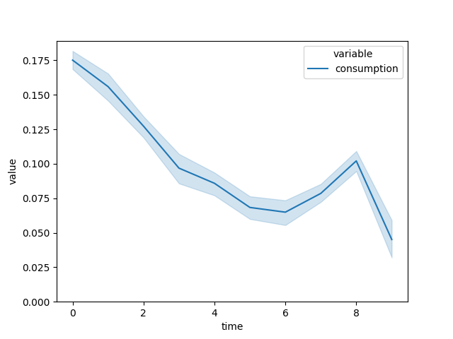
Constrained Present Value
Minimizing least squares residuals doesn’t actually work here because the gradients of the utility of consumption are unstable near zero. It’s cool that the RL method actually recovers the correct solution
Classical
RL

Slide 10
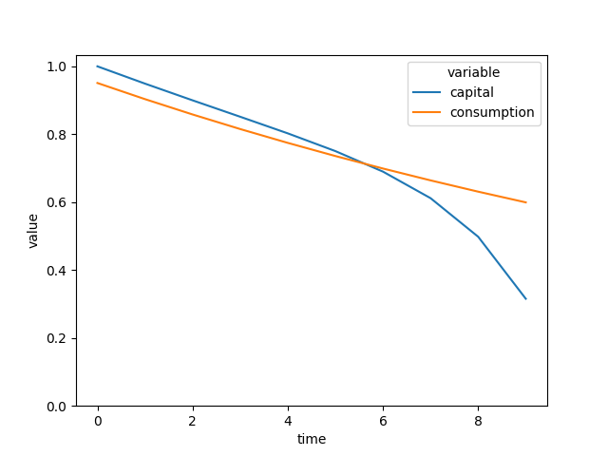
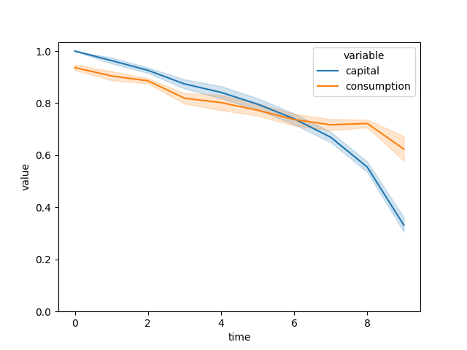
Capital Accumulation
RL finds a qualitatively similar solution to least squares residual method
Classical
RL

Slide 11
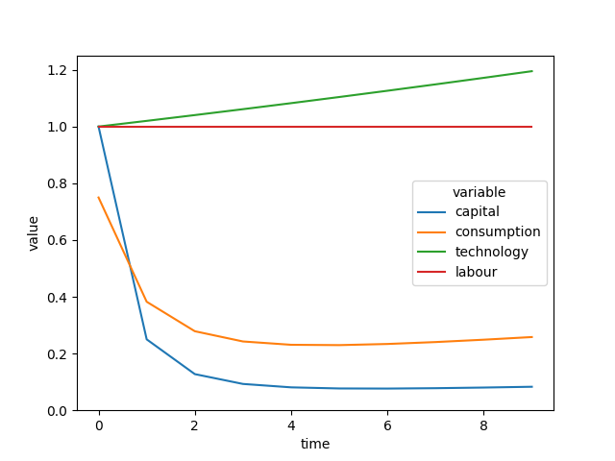
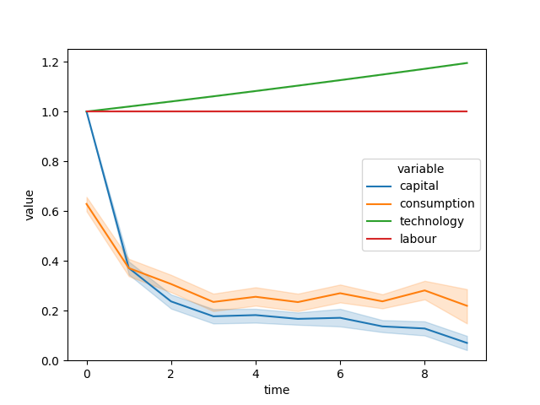
Simple Brock-Mirman RBC Model
RL finds a qualitatively similar solution to the closed-form classical B-M model
Classical
RL

Slide 12
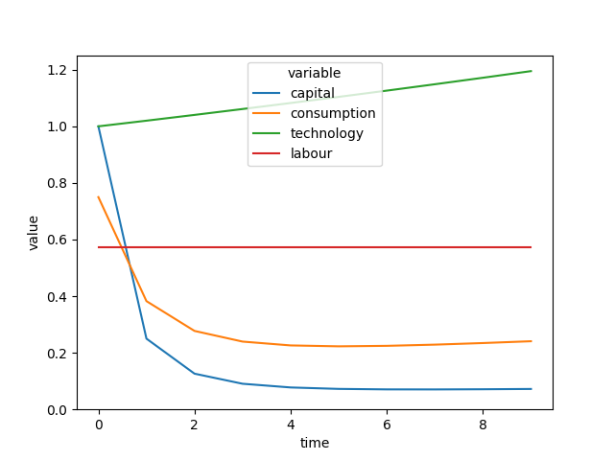
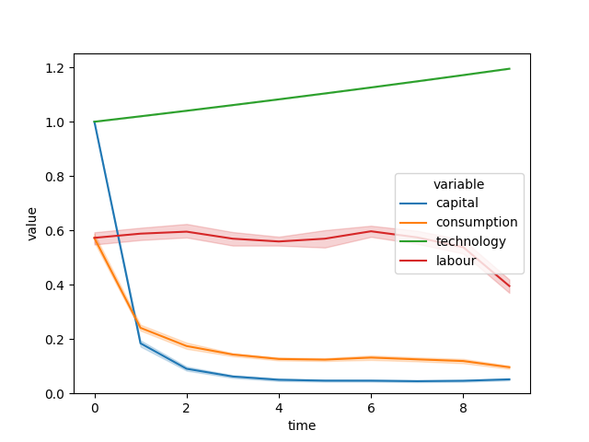
Brock-Mirman with Leisure
RL finds a qualitatively similar solution to the closed-form classical B-M model – even when it must decide on both labour and consumption
Classical
RL

